Slide 1
Parametarization of capacity demand:
EOM-ref and EOM-cap (no changes)
CM-NoCBP - Peak residual (inelastic) demand as capacity demand
Introduced CM-ref - joint scarcity assessment gains
CM-FBMC and CM-NTC – based joint scarcity assessment gains and explicit cross-border procurement.
CM implicit – based on joint scarcity assessment gains and deduction of expected imports

Slide 2
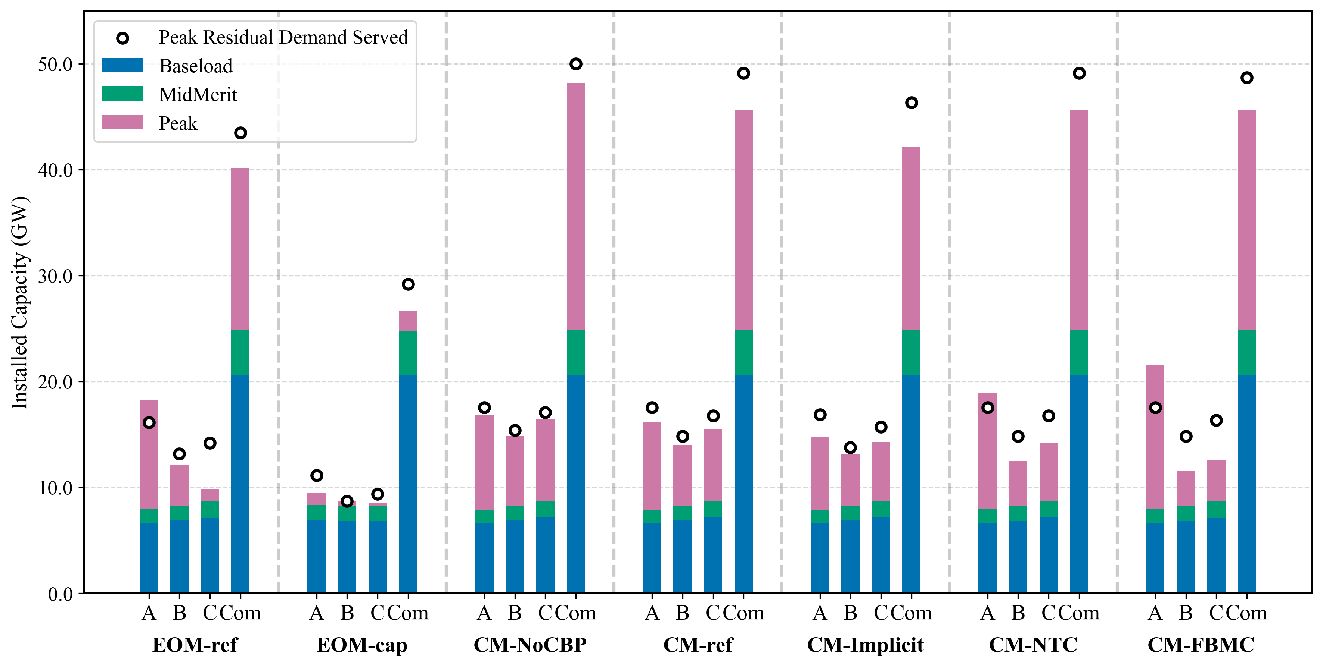
Installed capacity

Slide 3
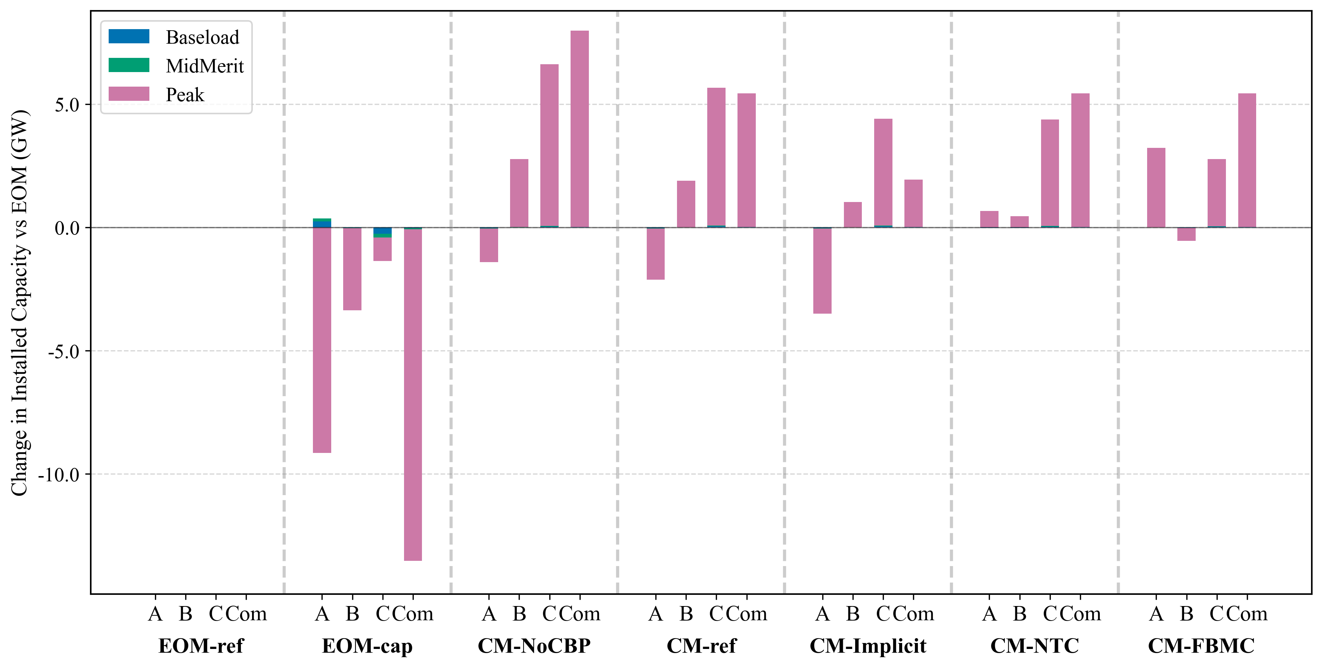
Change in installed capacity

Slide 4
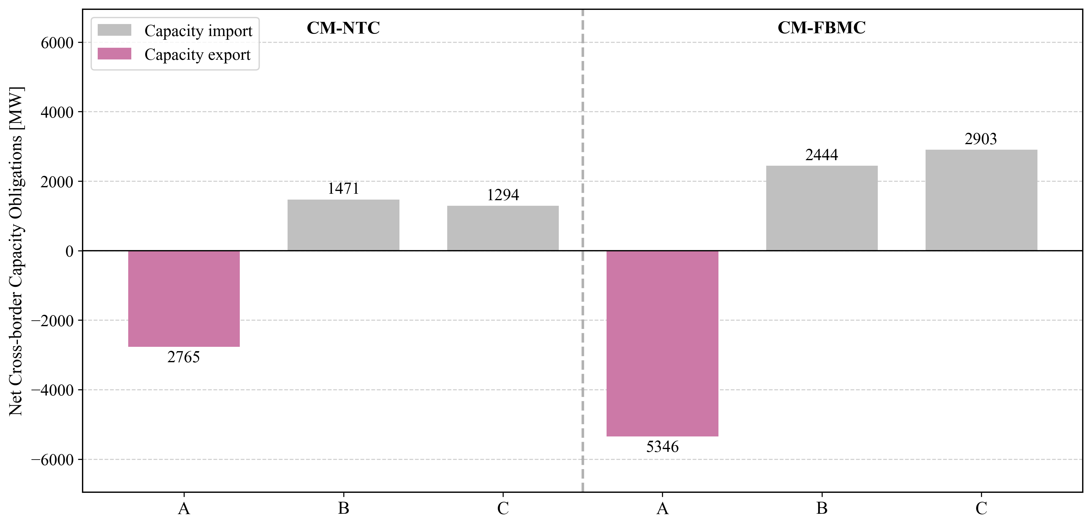
Capacity trade

Slide 5
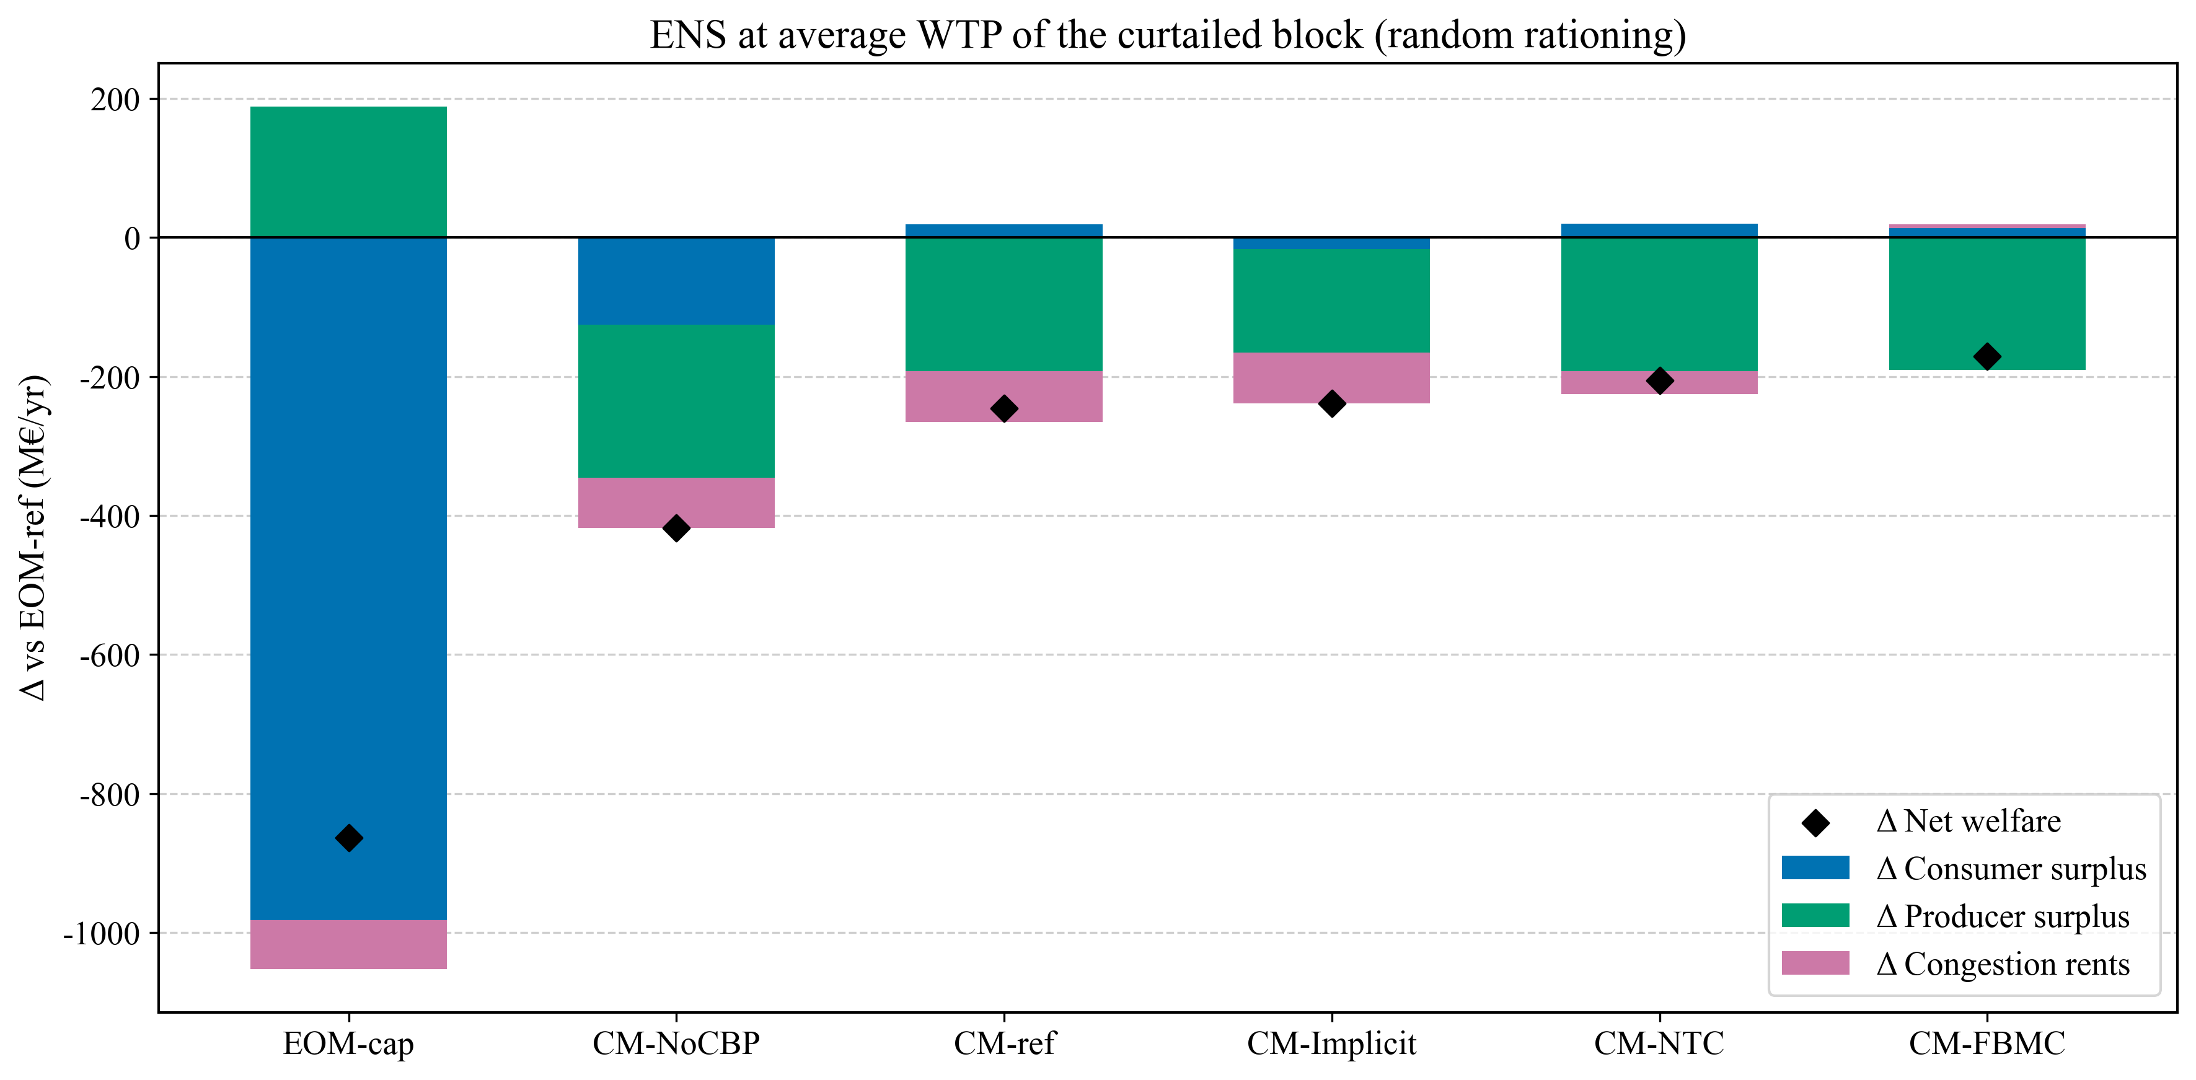
Welfare decomposition

Slide 6
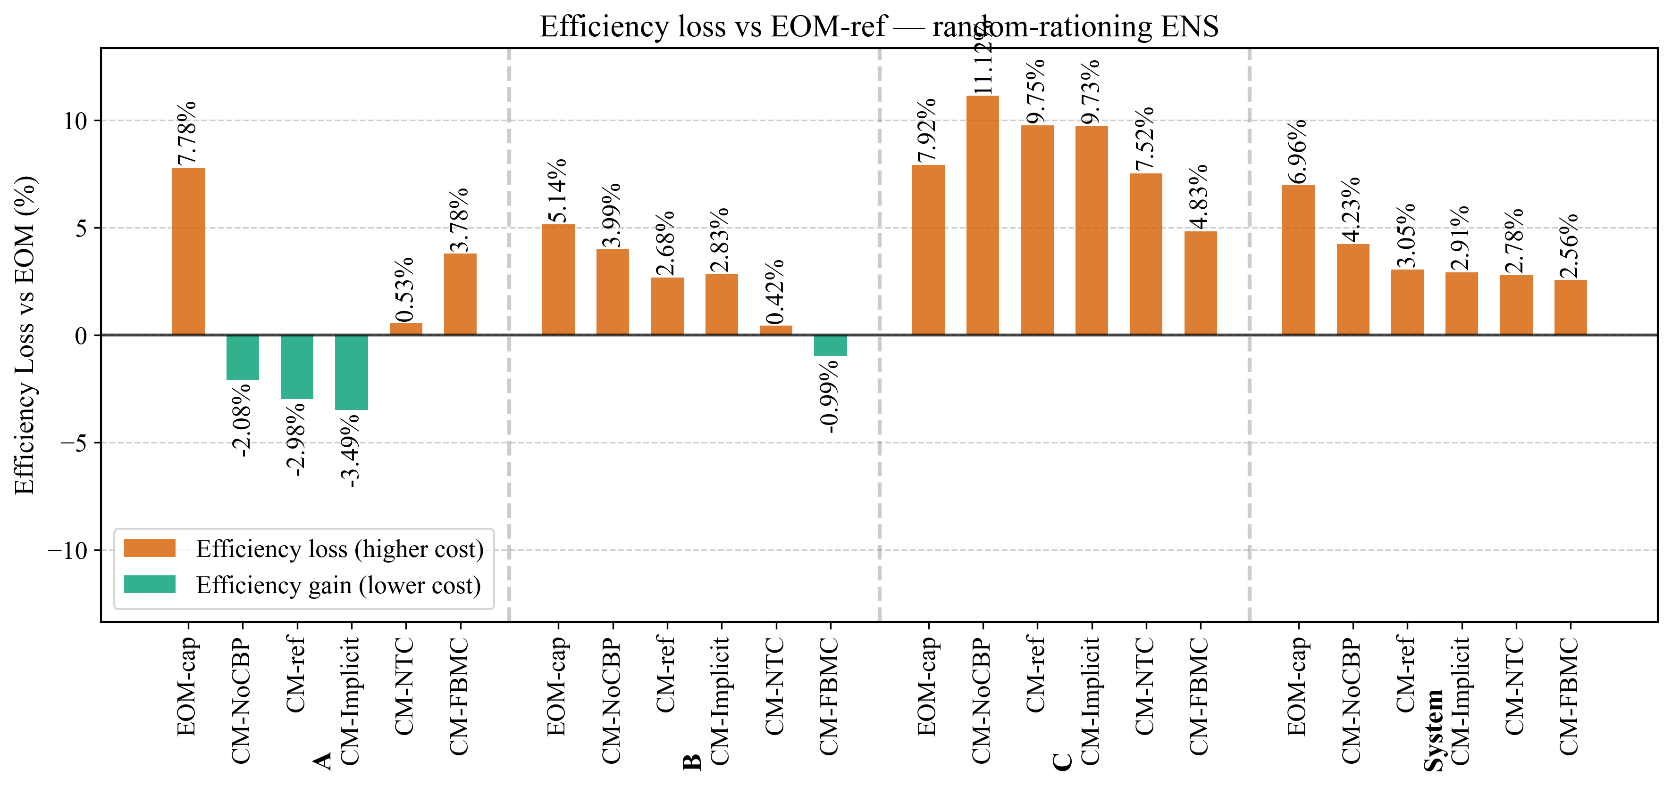
System costs

Slide 7
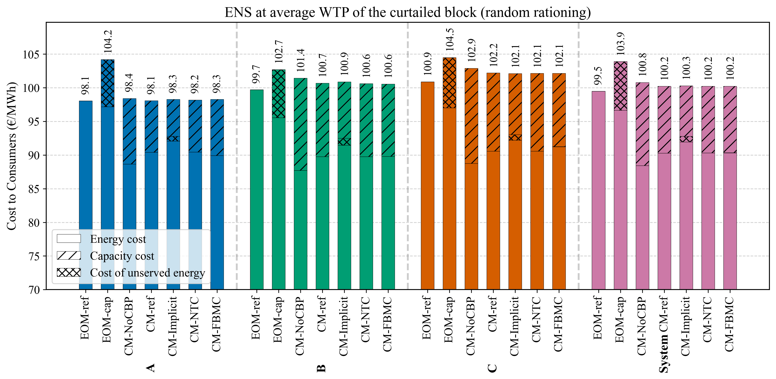
Avg consumer costs

